Slide 1
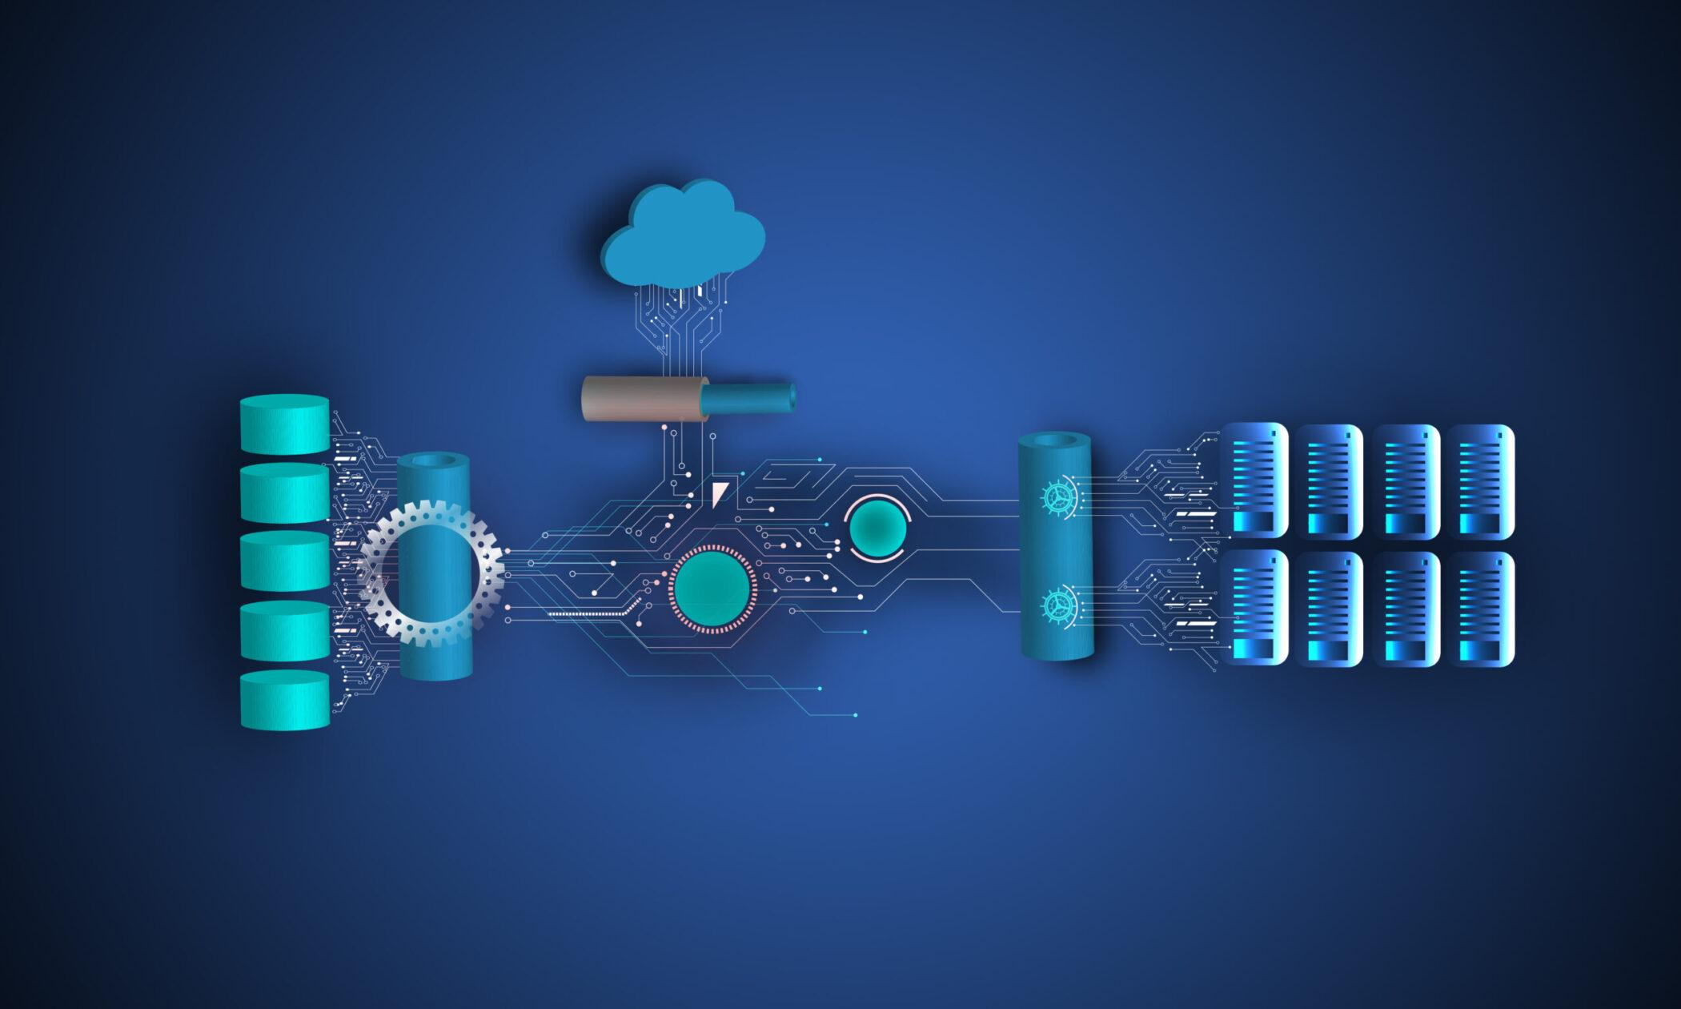
Scalable Services Assignment Nandini Agarwal, Stuti Suthar

Slide 2
static web page hosted on GitHub Pages
GitHub Repo Link:
https://github.com/nandini-agarwal/ScalableServicesExample
Webpage URL:
https://nandini-agarwal.github.io/ScalableServicesExample/

Slide 3
Microservice-Based Tic Tac Toe Game: Project Report

Slide 4
Introduction
The purpose of this project is to develop a microservice-based Tic Tac Toe game application using Java and Spring Boot. The application allows multiple players to play the game simultaneously through REST API endpoints. The project follows a microservices architecture, where each microservice handles a specific aspect of the game.
GitHub link: https://github.com/stutisuthar/ticTacToe

Slide 5
Design Approach
1. Microservices Architecture:
The application is designed using a microservices architecture, which promotes modularity, scalability, and maintainability. The key microservices in this project include:
Game Service: Responsible for managing the Tic Tac Toe game logic and state.
API Service: Handles the HTTP requests and serves as the entry point for players to interact with the game.
2.Game Service:
The Game Service is implemented as a Java class named `TicTacToe`. It encapsulates the Tic Tac Toe game logic and provides methods for making moves, checking the game status, and retrieving the game board. The Game Service ensures that multiple players can play the game simultaneously by maintaining the game state independently for each session.

Slide 6
Design Approach
3. API Service:
The API Service is implemented as a Spring Boot application. It exposes REST API endpoints for players to interact with the Tic Tac Toe game. The API Service communicates with the Game Service to handle game-related operations. It provides endpoints for making moves, retrieving the game board, and checking the game status.
4. Docker and Kubernetes:
The application is containerized using Docker, which allows for easy deployment and scalability. Each microservice is packaged as a Docker image. Kubernetes is used for container orchestration and managing the deployment of the microservices. The application can be deployed and scaled efficiently in a Kubernetes cluster.

Slide 7
Implementation Details
Game Logic Implementation: The game logic is implemented in the `TicTacToe` class. It includes methods for initializing the game board, making moves, checking for a winner, determining a draw, and updating the current player.
API Endpoints: The API Service exposes REST API endpoints using Spring Web. These endpoints handle HTTP requests for making moves, retrieving the game board, and checking the game status. The API Service communicates with the Game Service to perform the necessary operations and return the appropriate responses.

Slide 8
Implementation Details
Containerization: Each microservice is containerized using Docker. A Dockerfile is created for each microservice, specifying the base image, dependencies, and commands to run the services. Docker images are built for the Game Service and API Service.
Kubernetes Deployment: The Kubernetes Deployment and Service resources are defined using YAML files. The Deployment resource ensures the desired number of replicas of each microservice are running. The Service resource exposes the microservices internally within the Kubernetes cluster.

Slide 9
Conclusion
Conclusion
The microservice-based Tic Tac Toe game application demonstrates the usage of microservices architecture, Java, Spring Boot, Docker, and Kubernetes. The design approach allows for modularity, scalability, and ease of deployment. By following this approach, the application can handle multiple players playing the game concurrently and can be deployed and scaled efficiently using Kubernetes.
Overall, this project provides a solid foundation for building and deploying microservice-based applications and can serve as a starting point for more complex game applications or similar projects.

Slide 10
Docker
Traditional Deployment Process:
Without Docker, the deployment process typically involves the following steps:
Provisioning a server or virtual machine.
Installing the necessary dependencies (Node.js, NPM, etc.).
Setting up the required environment (configuring ports, installing libraries).
Transferring the application code to the server.
Building and configuring the front-end and back-end separately.
Managing and resolving any dependency conflicts or environment-specific issues.
Starting the back-end server and configuring it to listen on the correct port.
Configuring a reverse proxy or load balancer (if needed) to handle incoming requests.
Ensuring proper monitoring and logging setup.
This process can be time-consuming and error-prone, especially when deploying to multiple environments or scaling the application.

Slide 11
Docker
Dockerized Deployment Process:
Using Docker, we can simplify and automate the deployment process as follows:
Create a Dockerfile for the front-end and back-end, specifying the necessary dependencies and instructions to build the images.
Build Docker images for both components using the Dockerfile.
Push the built Docker images to a container registry (e.g., Docker Hub, AWS ECR).
Provision a server or virtual machine with Docker installed.
Pull the Docker images from the container registry to the server.
Run the Docker containers based on the pulled images, mapping the necessary ports.
Docker takes care of isolating the application's dependencies and environment, ensuring consistency across different environments.
Scaling the application becomes easier by spinning up multiple instances of the Docker containers, managed by an orchestrator like Docker Swarm or Kubernetes.
Monitoring and logging can be handled using Docker logging drivers and integration with monitoring tools.

Slide 12
Conclusion
This Dockerized deployment process eliminates the need to manually set up dependencies, configure environments, and manage separate deployments for the front-end and back-end. It provides a standardized and repeatable deployment process across different environments, making it easier to maintain and scale the application.
With Docker, the application can be deployed with a simple set of commands, reducing the deployment time and minimizing the chances of configuration errors.
Overall, Docker simplifies and automates the deployment process by encapsulating the application and its dependencies into containers, providing consistent deployment environments, and allowing for easy scaling and management of the application instances.

